Slide 1
Lecture Zero
Introduction & Nomenclature

Slide 2
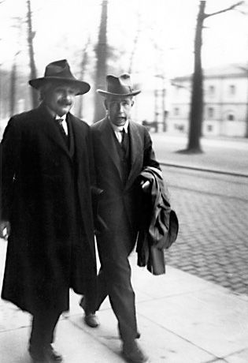
GEH1027 & GEK1508
General Education Module (GEM)
Einstein’s Universe & Quantum Weirdness

Slide 3
What is a GE module ?
a) General Education strives to develop and integrate a student’s knowledge, attitudes, skills and experiences in order to enable the student to engage in life long inquiry and decision making.
b) Provides a more satisfying life and a more effective citizen for society ... Also prepare students to succeed in today’s knowledge economy and global workforce.
M. R. Hall, S. M. Culver & P. L. Burge, Project Muse ... General Education Curriculum.

Slide 4
Why are we here ?
a) We want to learn about Relativity & Quantum Theories from a different angle (Human Culture Pillar … science is a cultural activity !) and catch on the excitement of these 2 great discoveries with more depth through the controversies surrounding them.
b) Stretch our minds and increase intellectual horizon … make life more meaningful; more connected to mother nature.
c) We need to fulfill General Education requirement.
d) No Examination … Open Book Test (MCQ & Short Questions)

Slide 5
GEM in the spirit of Liberal Arts
A human being is a part of the whole, called by us “universe,” a liberal arts education is not specifically tied to the arts and does not imply being liberal ... is one that samples liberally (that is, broadly) from the various domains of knowledge.
George D Bishop
ST, Tuesday May 31th 2011
i.e. Interdisciplinary student learning and encourage student to make connections ... social awareness

Slide 6
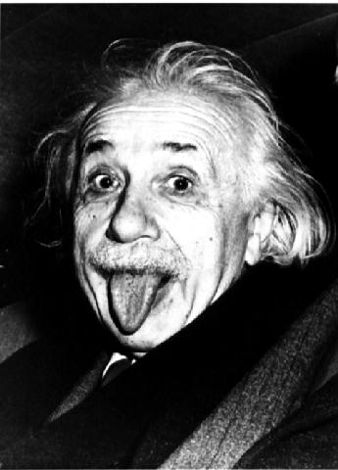
Widening circle of Awareness
A human being is a part of the whole, called by us “universe,” a part limited in time and space. He experiences himself, his thoughts and feelings, as something separated from the rest – a kind of optical delusion of his consciousness. This delusion is a kind of prison for us, restricting us to our personal desires and to affection for a few persons nearest to us. Our task must be to free ourselves from this prison by widening our circle of compassion to embrace all living creatures and the whole nature in its beauty. Nobody is able to achieve this completely, but the striving for such achievement is in itself a part of the liberation and a foundation for inner security. A. Einstein
(Nobel Laureate)

Slide 7
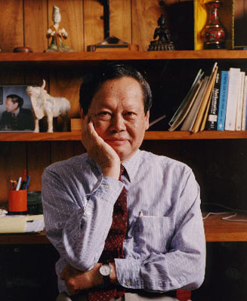
Example : C.N. Yang
“When I was nine or ten years old, Father had already observed that I was gifted in mathematics. When I reached the junior high school at age eleven, my ability in this direction was quite obvious. Looking back at those days, had he taught me analytic geometry or calculus at that time, I would certainly have made rapid headway which would probably have greatly pleased him. But he did nothing of this sort. During the summer vacation between grades seven and eight, I was instead coached by a Mr. Ding Zeliang, who was a student in the history Department of Tsing Hua University. Father asked him to teach me Mencius.
C.N. Yang, Father and I, Inst. Adv. Studies Supp. Newsletter, NTU (2013) P49-63
Nobel Laureate 1957, The Chinese Hong Kong University, Hong Kong

Slide 8
What a GEM module is not !
It is not :
a) a light module whereby students can cramp it as the 6th or 7th module after having registered a full load of 5 modules.
b) Just another introductory 1st year module ... there is no advanced knowledge nor need for deeper thinking since there is no rigour ... “Intellectually undemanding”

Slide 9
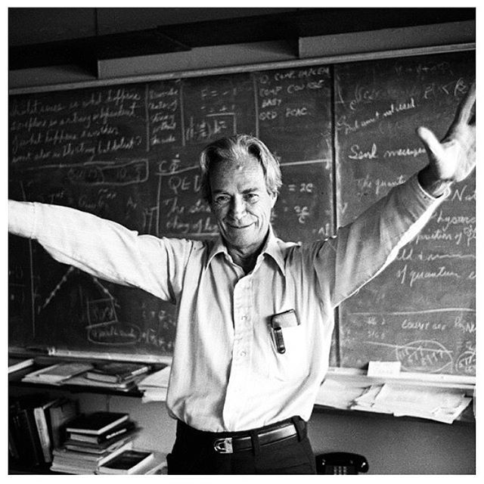
A Paradox on Rigour
Mistaking process for understanding.
“Just because a student can perform a technique that solves a difficult problem doesn’t mean that he or she understands the problem.”
Surely You’re joking, Mr. Feynman !: Adventures of a Curious Character

Slide 10
Why are we here ?
You like …
to read and think (& reflect) a lot ... evaluate ideas … to always keep an open mind (do not memorize unneccesarily !) to think privately first and discuss new ideas (lectures & tutorials) with others socratically & holistically.
Advice : What is the ratio to keep for private study ? 1 : 2 hrs
to be polite at the LUMINUS Forum Discussions
Group project work ! (no individual project … minus marks)
to sense the wonders of nature & to do star gazing ???

Slide 11
Topics to be Discussed
Galilean, Newtonian and Einsteinian Relativities, Principle of Relativity, Special & General Relativity, Nature of Space, Time & Light, Twin Paradox, Blackholes stars and Wormholes. E = mc², Big Bang, Dark Matter & Dark Energy, etc.
Quantum Physics (or Quantum Mechanics) Wave-particle duality, the uncertainty principle, probability waves, atoms, particle physics and Quantum Entanglement & Teleportation.
Unification of Relativity and Quantum Mechanics, Particle Physics & 4 fundamental forces, Quantum Field Theory & the Higg’s Particle
With Strings attached if Time permits.

Slide 12
Course outcome
Participants would be able to discuss modern physics (20th - 21st Century) meaningfully and intelligently with others.
Participants would be able to keep up with future discoveries and technologies, from magazines such as Scientific American, New Scientist, Physics World, Economist … etc
Scientific TV Channels & Documentaries : Discovery Science or National Geographic, Wikipedia, Scientific blogs … etc
Participants would be able to appreciate and enjoy the mysteries and beauties of mother nature.

Slide 13
About References & Books
Some e-materials will be uploaded

Slide 14
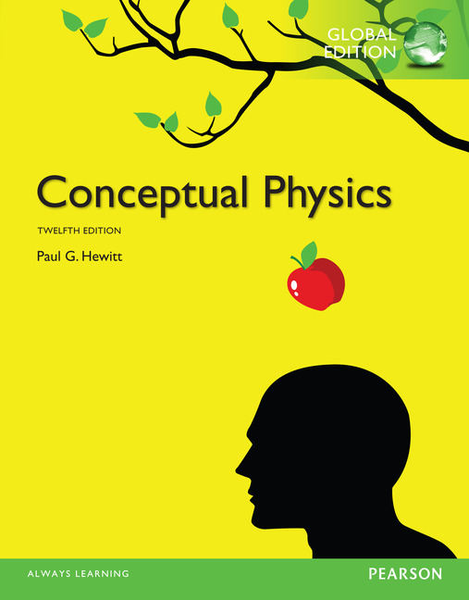
Students who have little Physics Background
A good book for those who do not have ‘O’ level Physics.
Students are expected to do simple mathematics
A educated & literate person must also be numerate !
Author : Paul G.Hewitt
Publisher : Pearson
ISBN : 9780321684929

Slide 15
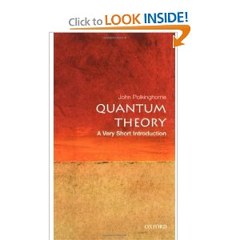
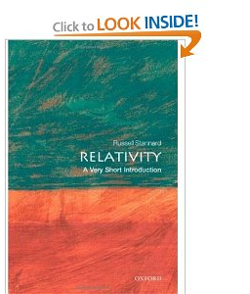
Inexpensive Oxford Books
John Polkinghorne, Quantum Theory,
Oxford U. Press
Russell Stannard, Relativity
Oxford U. Press
Good to own these 2 little books !

Slide 16
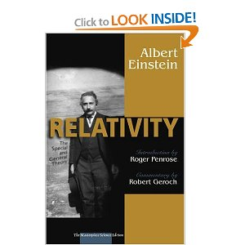
Relativity Books
With commentaries from :
Robert Geroch is Professor of Physics at the University of Chicago.
Roger Penrose is Emeritus Rouse Ball Professor of Mathematics at Oxford University.
David C. Cassidy is a Professor in the Natural Science Program at Hofstra University. Pearson Education (2005)
A. Einstein, Relativity, Penguin Classics, (2006)
S. Hawking, The Universe in a Nutshell (with lots of nice pictures with serious discussions) Bantam Books, 2001

Slide 17
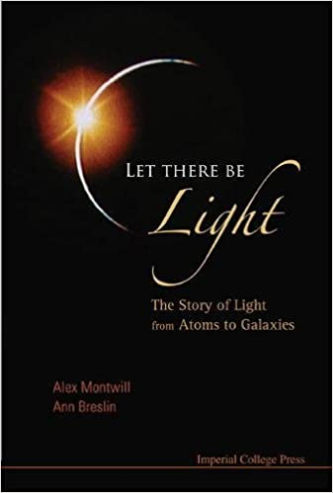
Quantum & Relativity Book
Let There Be Light:
The Story Of Light From Atoms To Galaxies
A. Montwill and Ann Breslin, Let There Be Light, Imperial College Press. World Sci. (2008)

Slide 18
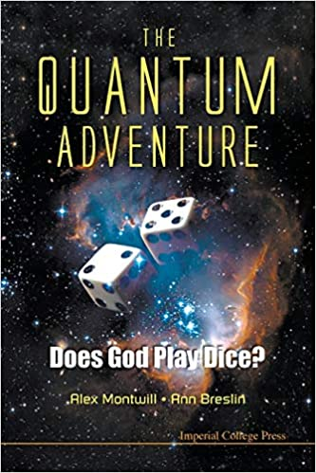
Quantum Book
Quantum Adventure:
The: Does God Play Dice?
A. Montwill and Ann Breslin, Quantum Adventure, Imperial College Press. World Sci. (2011)

Slide 19
Why should we read ?
To hold that you know a thing when you know it and to hold that you do not know when you really do not know. … that is knowledge. Confucius (551-479 BC)
Employ your time in improving yourself by other men’s writing so that you shall come easily by what others have laboured for.
Socrates (469-399 BC)
Science is a way of thinking much more than it is a body of knowledge.
Carl Sagan (1934-1996)

Slide 20
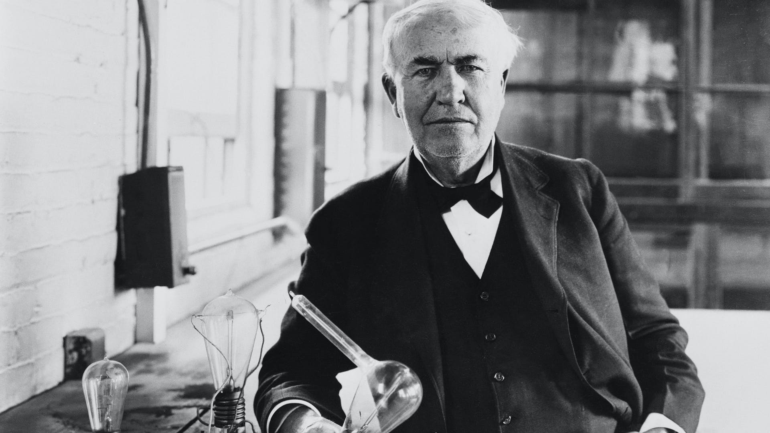
The Art of Reading
The art of reading is among other things, is the art of adopting the pace of the author has set. Some books are fast and some are slow, but no book can be understood if it is taken at the wrong speed.
There is no substitute for hard work.
Thomas. A. Edison
Reading also helps one to think critically ! ΦL

Slide 21
About Lectures
Introduction & Nomenclature

Slide 22
Our Method of Enquiry 1
Socrates Thoughts, 469 to 399 BC Greek Philosopher
He initiated a method of teaching through questions and answers whereby man could get to know himself. His method is characterized by philosophical method of instructions and arguments. His theories have survived only through the writings of Plato, his most important student and to a lesser extent of Xenophon …
The Universal Dictionary
“Studying philosophy in Athens in Greece, I was taught that to really learn anything one had to throw away one’s textbooks and notebooks … and rely on one’s ability to critically think through a situation … No campus required. Thinkers like Plato wandered about Athens engaging their students in mind stretching debates …”
Prof Vicky Phillips
The Straits Times, April 6th 1999

Slide 23
Our Method of Enquiry 2
Everything should be made as simple as possible but not simpler …
A. Einstein (1879 – 1955)
After all, analogy is a time–honored method of learning …
K. L. Chung
Probability Theory, 1978
Students may expect some very simple algebra, matrices & calculus … please so do not be angry with me !

Slide 24
Occam’s Razor
A principle of scientific and philosophical discussion urging the use of the most economical and least complex assumptions terms and theories. It is usually formulated as “Entities should not be multiplied unnecessarily”
variant of Ockham’s razor

Slide 25
Our Method of Enquiry 3
To understand a science it is necessary to know its history.
Auguste Comte (1798 – 1857)
Positive Philosophy
There are times, what history should not teach is what one should think. Rather history should also teach one how to think. The present situation is such, that a lot of people do not understand how mankind got to such a situation, and without proper comprehension how are we going to solve future physics problems.
“Physics without philosophy would be blind; philosophy without physics would be lame” … this sentiment, adapting Einstein’s famous comment on Science and Religion,
Physics World 2008, England, UK p37

Slide 26
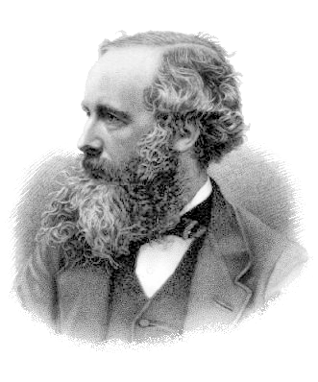
Physics with History
Furthermore, Maxwell noted the value of history of science in teaching: “The history of the development … of ideas is of all subjects that in which we, as thinking men, take the deepest interest.”
In the lecture, Maxwell said, “It must be one of our most constant aims to maintain a living connexion between our work and the other liberal studies of Cambridge, whether literary, philosophical, historical or philosophical.” His idea of interdisciplinary study is fully consistent with the view of science education espoused today by liberal arts colleges.
Genrikh Golin, J.C. Maxwell, A Modern Educator, Physics Today June 2013
Gutenberg eBook (2004) : J.C. Maxwell, Five of Maxwell’s Papers

Slide 27
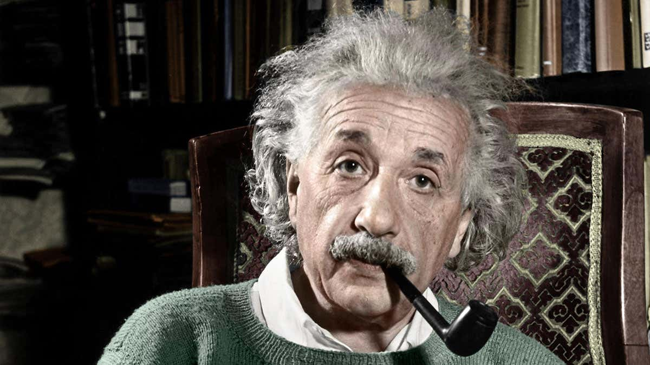
Physics without Philosophy is Blind
“Physics without philosophy would be blind; philosophy without physics would be lame” … this sentiment, adapting Einstein’s famous comment on Science and Religion.
Albert Einstein
Nobel Laureate, 1879 – 1955
Genrikh Golin, J.C. Maxwell, A Modern Educator, Physics Today June 2013
Gutenberg eBook (2004) : J.C. Maxwell, Five of Maxwell’s Papers

Slide 28
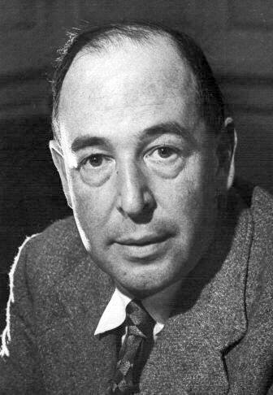
The benefits of studying philosophy for science education
Good philosophy must exist, if for no other reason, because bad philosophy needs to be answered.
The Weight of Glory
C. S. Lewis, Oxford U
Andrew Loke, Hong Kong University
http://www.nus.edu.sg/teachingacademy/article/the-benefits-of-studying-philosophy-for-science-education/

Slide 29
Ensure that you do not have time-table clashes

Slide 30
2 MCQ Term Tests
Test 1: Wednesday, 3rd Mar 2021 (7th week)
Test 2: Wednesday, 7th April 2021 (13th week)
Duration: 1 Hour plus (Please do not be late)
~ 30-35 MCQ + ~ 5-10 short Questions
(10am to 12pm lecture slot)
Mode: LumiNus Quizzes, short Questions; require short Answers

Slide 31
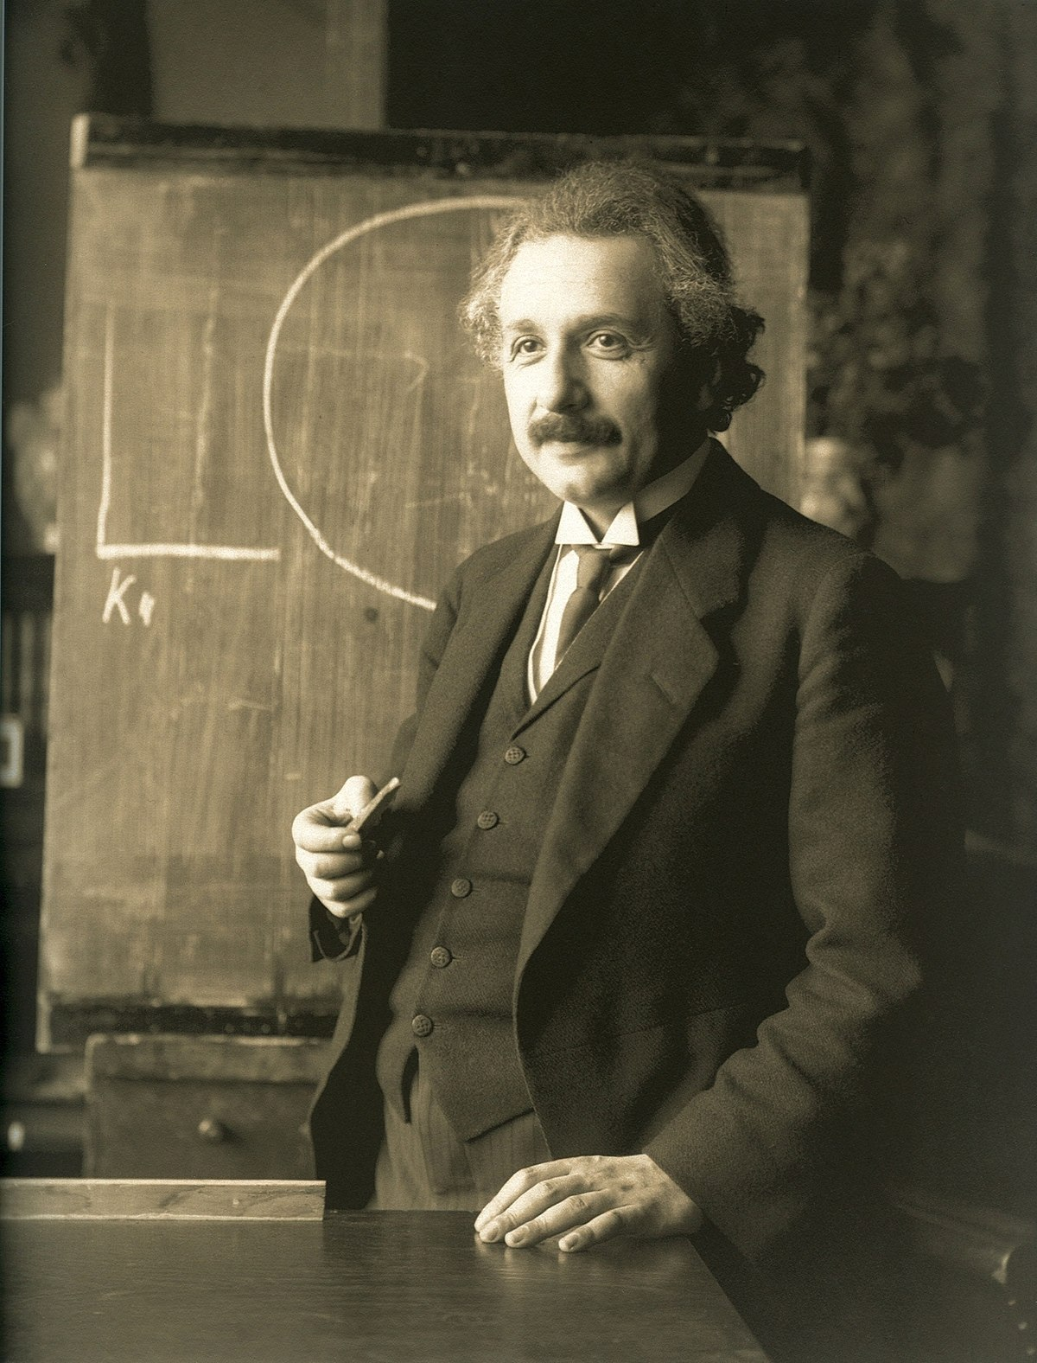
About Term Tests
Of course, our ability to retrieve information from our memories is a function of how well it was learned in the first place.
But the Art of Questioning ...
Most teachers waste their time by asking questions which are intended to discover what a pupil does not know whereas the true art of questioning has for its purpose is to discover what the pupil knows or is capable of knowing.
A. Einstein (1879 - 1955)

Slide 32
(CA) Continual Assessment
Prepare and be active during Tutorial and LumiNUS Forum

Slide 33
About CA
There are 5 Tutorials (fortnightly) (begins 3rd week)
Class Assignments: 20 % (hand in during tutorials)
(LUMINUS): 10 % (min. of 10 meaningful posts)
Tutorial Attendance: 5 %

Slide 34
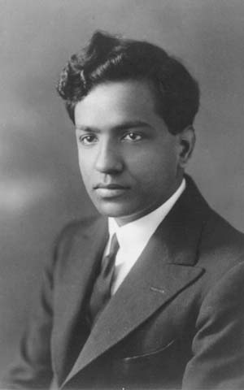
About our Tutorials
Learning or Knowledge
学问
Learn to Ask ?
S. Chandrasekhar
(1983 Nobel Laureate)
Story : Did you ask a good question ?

Slide 35
How should one approach your tutorials i ?
Creative Teaching and Learning . . .
Students must be allowed to make and learn from their own mistakes. It amazes me how quickly you can turn off students by telling them the answer to their questions rather than having them do experiment and listen to nature’s response to their question.
When students become accustomed to hearing about and working with things that they do not completely understand, they are well on their way to becoming practicing scientists.
The role of the teacher in this system is to show the student how to decide what are important questions, and to listen to and evaluate the answers that nature gives. After all, there is no higher authority in physics than nature itself.
Journal of Undergraduate Research in Physics, Sigma Pi Sigma, Vol. 12 #1

Slide 36
How should one approach your tutorials ii ?
Judge a man by his questions rather than by his answers. Voltaire
Curiosity is one of the permanent and certain characteristics of … … ... a vigorous mind.
Samuel Johnson, The Rambler, (1709 - 1784)
One must learn by doing the things; for though you think you know it, you have no certainty until you try.
Sophocles, Greek Dramatist (495-406 BC)
Reminder: There is no substitute for hard work. Thomas. A. Edison

Slide 37
Small Assignments (CA)
… to be handed in during Tutorials

Slide 38
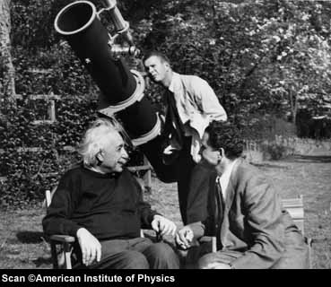
Imagination is more important than knowledge. A. Einstein
One must learn by doing the things; for though you think you know it, you have no certainty until you try.
Sophocles (495 – 406 B.C.)
Greek Dramatist

Slide 39

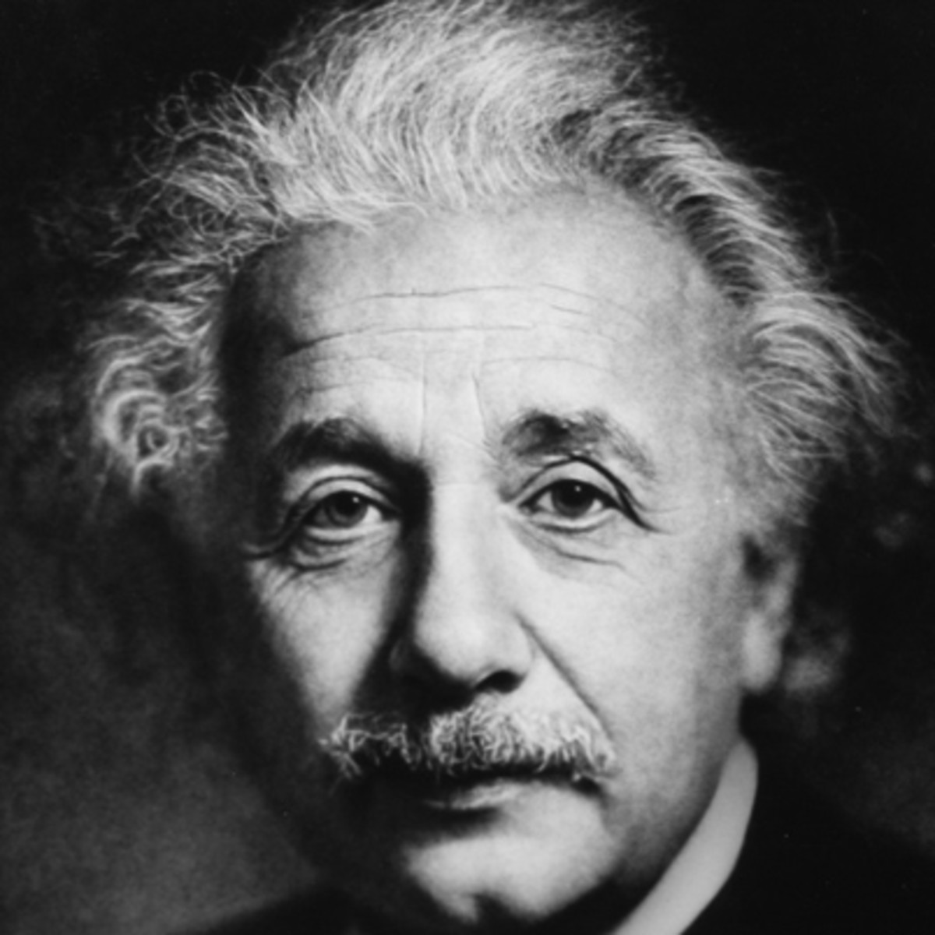
About Reading too much !
Reading, after a certain age, diverts the mind too much from its creative pursuits.
Any man who reads too much and uses his own brain too little falls into lazy habits of thinking.
A. Einstein
Quote from an interview with G.S. Viereck, "What Life Means to Einstein," Saturday Evening Post, October 26, 1929; re-printed in Viereck, Glimpses of the Great, 437.

Slide 40
Reading too much !
This isn’t exactly the best known quote by Einstein and I doubt many teachers quote this to their students. Reading is generally a good thing, but if it starts becoming a substitute for thinking on your own it can hold you back from reaching your potential.
This quote touches on a problem that holds many people back from actually accomplishing things. It is easy to spend so much time researching that you never actually execute. That doesn’t mean you shouldn’t read, do research and try to learn from others, but at some point you have to decide that you’ve gathered enough data and the time has come to do something. That may be starting your own business, writing a book or even repainting your living room. You have a very finite lifespan. Some people spend their life preparing for what they want to do without ever actually doing what they want to do. Sometimes the most helpful situations are the ones that force you to go ahead and do something by removing the option to try to collect more information.
http://www.productivity501.com/are-you-reading-too-much/8874/

Slide 41
(CA) About LumiNUS Forum
Think about the ideas presented (in Zoom Lectures & Tutorials) by yourself and participate in Forum discussions.

Slide 42
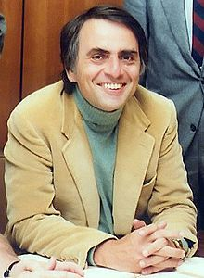
Scientific Scholarship : change your position
In science it often happens that scientists say, “ you know that’s a really good argument; my position was mistaken,” and then they would actually change their minds and you never hear that old view from them again. They really do it. It doesn’t happen as often as it should, because scientists are human and change is sometimes painful. But it happens every day. I cannot recall the last time something like that happened in politics or religion ….
Carl Sagan
Astronomer

Slide 43
either a Critical Book Review ( read 2 books) or a short 3 - 4 mins Filmlet / Movie
Group Project (Presentation & Viva)
Due date:
Only on (Thursday), 8th April 2020 (12th week)
a) Hand in (Hardcopy) before 6.00 pm.
b) (submit also softcopy essay or video in IVLE for plagiarism check)
(2 Tutors’ office or my office) Must be strictly adhered to. So sorry …
… no late submissions will be entertained (minus marks)

Slide 44
Term Paper
Form up to groups of 2 or 3 (if possible different majors … one extra mark) students (but not one student !)
Write a critical book review for 1 book chosen from the reference (or otherwise) given in this module … (i.e. but read at least 2 books … why ? )
Or create a short Filmlet (not more than 3 to 4 minutes) story (illustrating Relativity or Quantum Mechanics concepts)

Slide 45
Term Paper
Not more than 3000 words (for 3 students) or 2000 words (for 2 students)
1 and a half spacing between lines
No fanciful fonts (size 12) e.g. Quantumrelativity
What is a Critical Review of a book?
Your comments and ideas (contrast/compare etc)
Need to read a second book on the same topic
Accuracy of ideas in the book (pub. date)
Your original thoughts (agree or disagree ?
recommendation etc … ) … Language is important

Slide 46
Term Paper Etymology
The noun “essay” derives from the Old French essai, “trial”. It’s original 16th century meaning in English was “an attempt, an endeavour”. The verb “essay”, meaning “to test the quality of ”, is an alteration of assay, by association with Old French essayer: this is based on late Latin exagium ‘weighing’, from the base of exigere ‘ascertain, weight’ ’’
The Oxford Dictionary of Word History
Essay: to weigh facts : to attempt an argument; to ascertain and probe; to place thought on Trial.
“On Words” by Janadas Devan

Slide 47
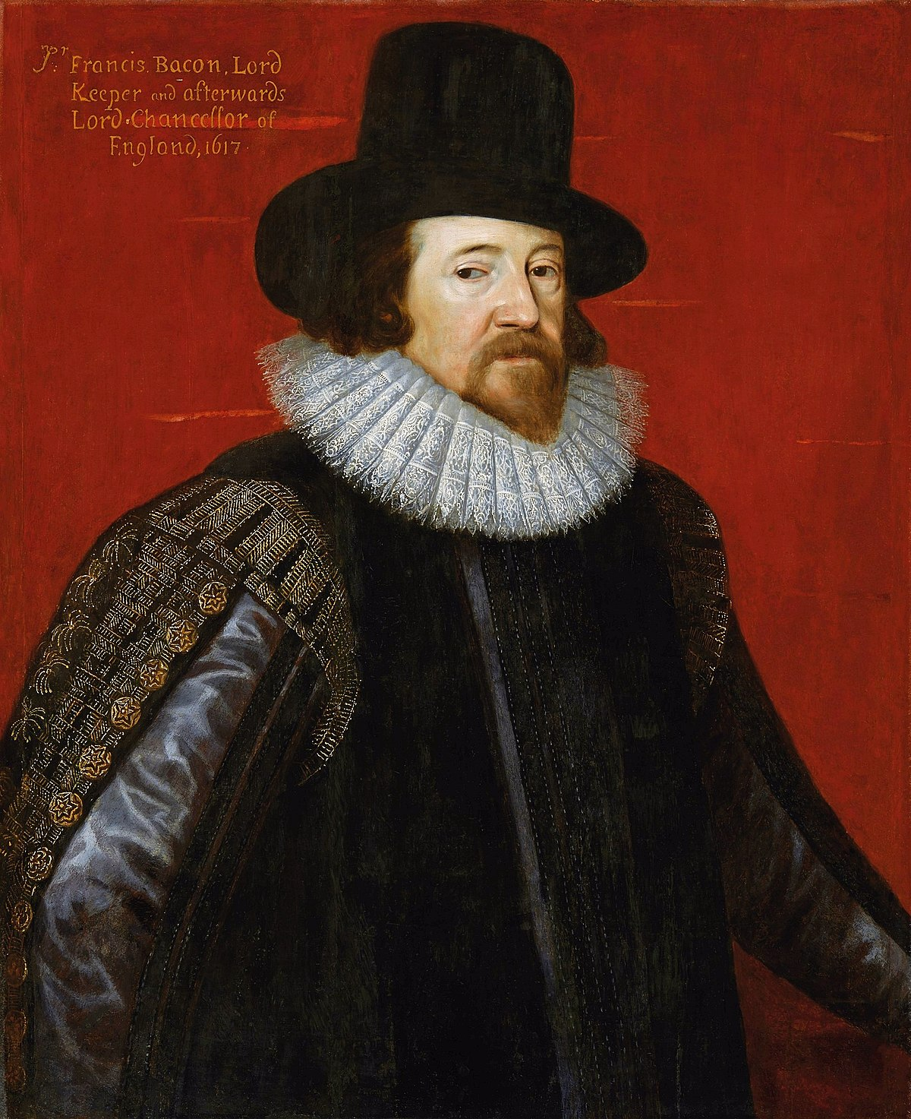
Term Paper Etymology
Read not to contradict and confute; nor to believe and take for granted; nor to find talk and discourse; but to weigh and consider.
Francis Bacon,
1561 – 1626
Lord Chancellor, Cambridge University
F. Bacon, Of Studies; English Essayist 1625.

Slide 48
Some Very Interesting Read
J. Polkinghorne, Quantum Theory, A Very Short Introduction, Oxford University Press (2002).
P. Davies, God and the New Physics, Penquin Books (1999).
G. Zukav, The Dancing Wu Li Masters, Perennial Classics, an imprint of HarperCollins Pub. (2001).
F. Capra, The Tao of Physics, Shambhala Pub. Boston, distributed by Random House (1999).

Slide 49
You may use other more recent books for book review !
Some critical comments on books for Critical Review !

Slide 50
Cartoon Physics Books (cannot be used for book review)
G. Callender and Palph Edney, What is Time ?, Totem Books, 2001
J. Schwartz and M. Mcguinness, Einstein for Beginners, Pantheon Books, N.Y. ,1979.
I.P. McEvoy and O. Zarate, Introducing Quantum Theory, Totem Books, U.S.A., (1997).
I.P. McEvoy and O. Zarate, Introducing Stephen Hawking, Totem Books, 1997

Slide 51
3 – 4 mins-Filmlet/Essay
2-3 students
(different majors … all students must be in the Filmlet)
To illustrate Relativity/Quantum Theories taught in this class or a Story on the above theories

Slide 52
Term Paper or Filmlet
A title page: state :
Your name, Matric # & Degree/major, email
A short Abstract / Summary
State: Is it a Book Review or Filmlet ?
(state Relativity or Quantum or both) !
Or a book review ? (state the name of the books)
Content pages (Optional); footnotes
A Reference / Bibliography page / Websites

Slide 53
How should one approach the term paper or filmlet ? i
Imagination is more important than knowledge. A. Einstein
The best way to have a good idea is to have a lot of ideas.
L. Pauling Nobel Laureate
In work; is the chance to find yourself.

Slide 54
How should one approach the term paper or filmlet ? ii
Great works are performed not by strength but by perseverance.
Samuel Johnson
Why do physicists write papers for publication ?
These journals provided not only a means for storing data, but a means for exploring their thoughts and ideas. They in fact learned through writing …
… a few people are beginning to realise that writing is an important learning tool as well as a means of communication.
S. J. Farlow
University of Maine

Slide 55
How should one approach the term paper or filmlet ? iii
What I cannot create ... I do not understand.
R. Feynman, Nobel Laureate
Creative Imagination
The formulation of a problem is often more essential than its solution ...
To raise new questions, new possibilities to regard old questions from a new angle requires creative imagination.
A. Einstein and Infeld

Slide 56
Some Simple Things !

Slide 57
What is expected from the participants?
Please be punctual for lectures and tutorials. Be enthusiastic ! …
Participants may find it hard to follow the arguments if you’ve missed some lectures or tutorials. Make quick notes during lectures or tutorials and please carry a coloured hi-lighter.
Review your previous lecture before you come for lectures.
Print the next power point lecture and read briefly in anticipation for the new lecture.

Slide 58
Lecture Slots
Date: Wednesdays 10.00 pm to 12.00 pm
Venue: Zoom (No timetable clashes)
Date: Friday: 10.00 pm to 12.00 pm
Venue: Zoom (No timetable clashes)
Important Note:
You should ensure that you do not have other lectures/tutorials on these slots. i.e. no timetable clashes !

Slide 59
Assessment

Slide 60
Assessment
Tutorials (CAs): 35 % (start: 3rd week)
MCQ Test 1: 20 % ( 7th week)
Term Project: 25 % (due: 12th week, short ppt Presentations/Vivas)
MCQ Test 2: 20 % (13th week)
Final Grade: 100 %
Notes: No Examination (only 2 MCQ Tests)
Tutorials begin on week 3
CAs : Tutorial Attendance (Active !) / Assignments
Forum participation (Active !)

Slide 61
Our Contacts
Assoc. Prof. Phil Chan
Office : S13-03-07
Tel : 6516-6390
Email: phycahp@nus.edu.sg
Consultation Period:
Before or after class or whenever you can find me in office (Zoom) or thru email appointment.
Mr. Ang Han Wei (Tutor)
Office : HEP laboratory
(Physics Block S13, level 3,
Email: ang.h.w@u.nus.edu
Consultation Period: Tutorial slots : To be announced (TBA) or Zoom
PhD candidate & NUS Research Scholars in High Energy Particle Physics.

Slide 62
GEH1027
General Education Module (GEM)
Einstein’s Universe & Quantum Weirdness

